Slide 1

RIDE-SHARING APP SAFETY VS. USER CONVENIENCE
Lisbeth Ruiz

Slide 2
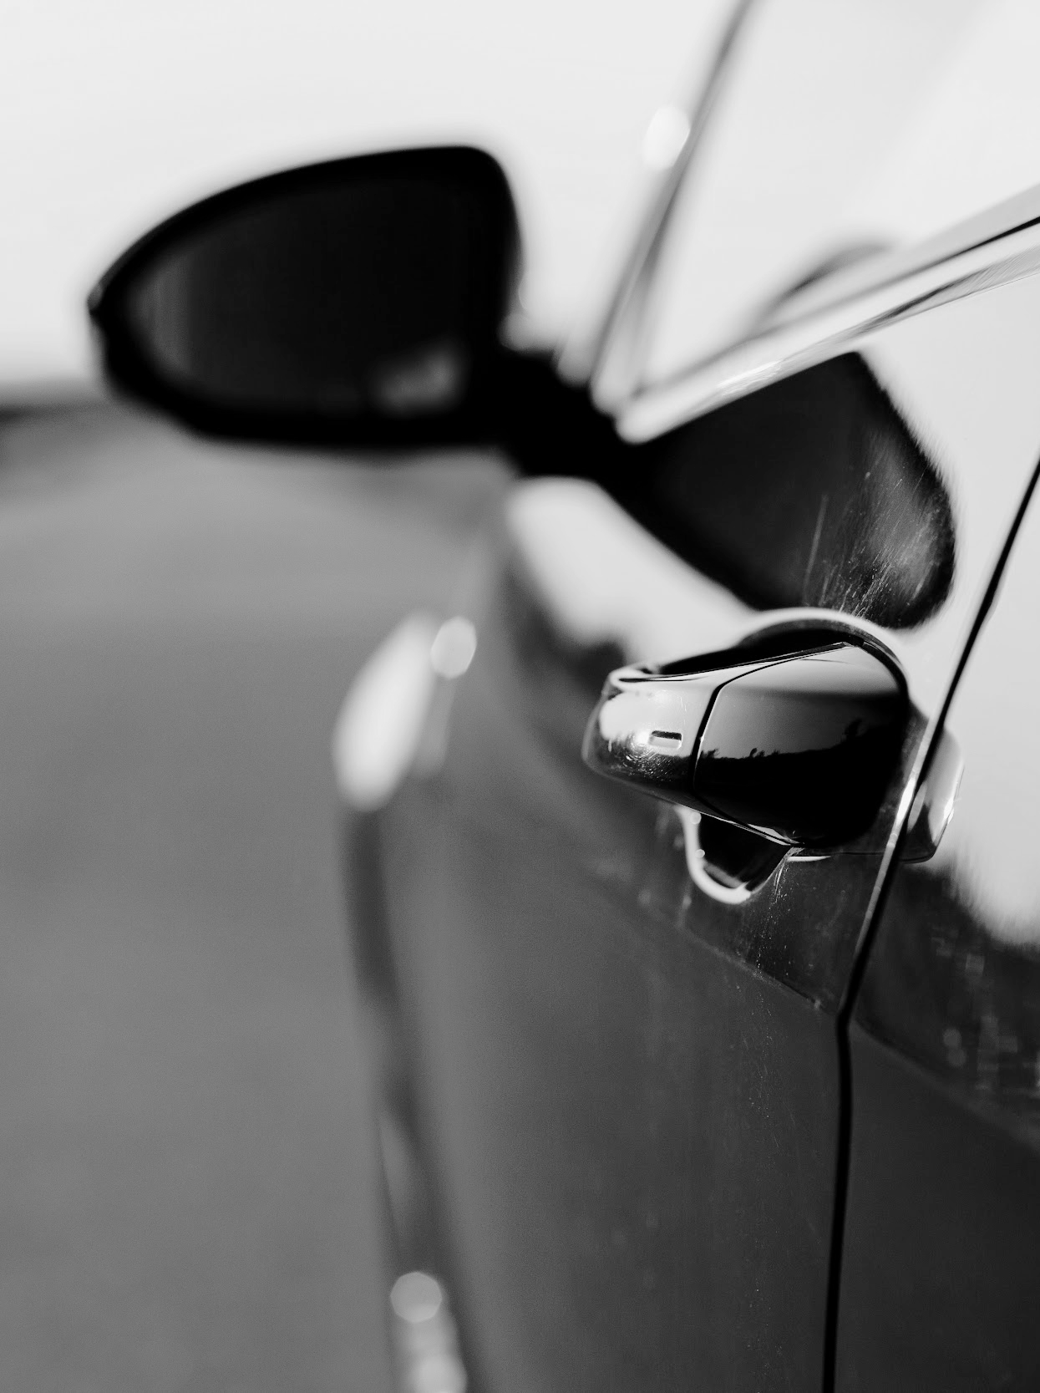
RIDE-SHARING
Ride-sharing is a service that coordinates one-way transportation on short notice with nearby drivers. These services have become popular due to their convenience and cost-effectiveness compared to traditional taxis. The most popular ride-sharing companies are Uber and Lyft.

Slide 3
PASSENGER SAFETY
CONVENIENCE
VS
One of the most paramount concerns for ride-sharing users is passenger safety. Measures must be implemented to protect passengers from potential accidents, harassment, or criminal behavior. Driver background checks have been an important topic when discussing passenger safety.
The biggest perk of using ride-sharing apps is the convenience of a quick ride. Being able to find a driver to pick someone up at an exact location quickly is what made these companies popular.
Striking the right balance between thorough screening and timely onboarding is essential.

Slide 4
CRIMINAL BACKGROUND CHECKS
WEAKNESSES
STRENGTHS
THREATS
Uber and Lyft have similar background check processes. Local and state regulations have different regulations for drivers to pass, which often proves to be a weakness. A lawsuit in 2016 indicated that the companies used low-cost background checking services, failing to access databases with complete criminal histories. Many argue that these background checks should be more thorough to ensure passenger safety.
Not rigorous enough and often misses convictions and offenses
Checks for moving violations, DUI’s, violent crimes, and sexual offenses
The longer the vetting process, less drivers available. Decreasing convenience for customers

Slide 5
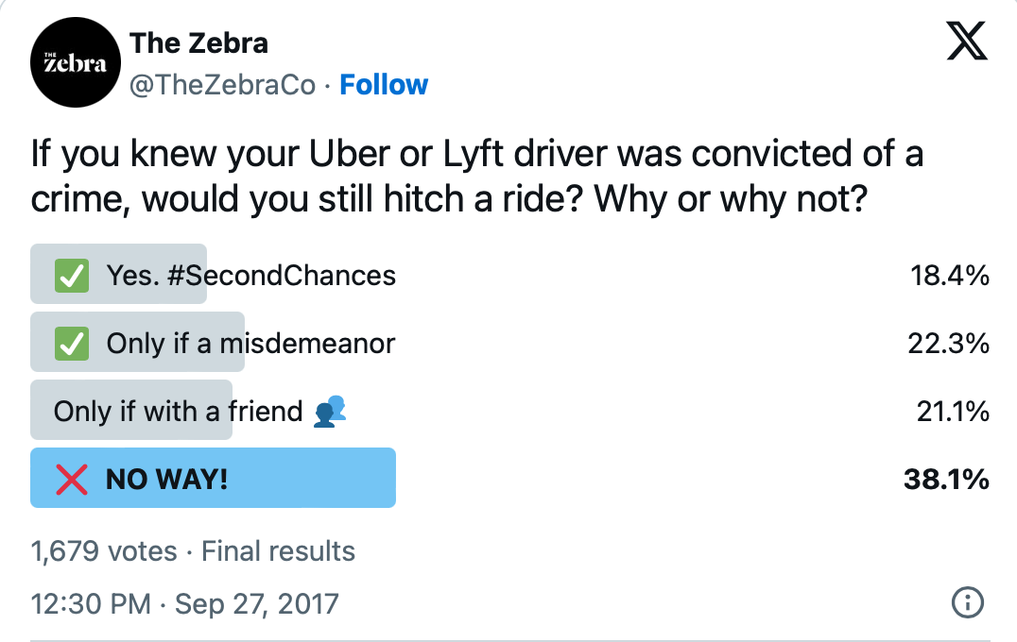
IMPORTANT INFO
According to Uber’s second US report, they reported over 3,824 reports of sexual assault and misconduct from 2019 through 2020. Lyft’s community safety report concluded that 4,158 sexual assaults occurred between 2017 and 2019.
“In some cases, the background check completely missed driving infractions or arrest records, allowing known dangerous individuals to become drivers. In other cases, individuals were refused from the platform because the background check picked up incorrect information showing they had been convicted for crimes committed by other individuals.”

Slide 6
OVERVIEW
The dilemma ride-sharing companies have to face revolves around finding the right balance between convenience and safety. The information shown, proves that it is difficult to find the right equilibrium. Enforcing stricter background checks and safety protocols could slow down driver onboarding, potentially resulting in longer wait times for users. On the contrary, focusing on convenience too much could jeopardize safety standards.

Slide 7
LINKS
https://www.thezebra.com/resources/research/background-checks-rideshare-drivers/
https://tritonvoice.co/8842/travel-transportation/ride-sharing-services-does-the-convenience-outweigh-the-safety-risk/
https://helpingsurvivors.org/rideshare-sexual-assault/how-are-drivers-vetted/

